Slide 1

Performance Evaluation Game Evaluating Human Resources Problems with Game Theory
Jared Seifter

Slide 2
Problem
There is a lack of human resource data because of privacy concerns and company secrecy for competitive advantage
Empirical results available tend to look for optimization of turnover, productivity, and overall company performance, but these outcomes are not always in sync
It is difficult to tie these results causally to the specific human resource strategy because of the many confounding variables

Slide 3
Problem
There is a lack of human resource data because of privacy concerns and company secrecy for competitive advantage
Empirical results available tend to look for optimization of turnover, productivity, and overall company performance, but these outcomes are not always in sync
It is difficult to tie these results causally to the specific human resource strategy because of the many confounding variables
Solution: Theoretical modeling using game theory

Slide 4
Optimizing the Performance Evaluation Game
The performance evaluation game is dynamic and quasi-cooperative because there are repeated performance evaluations at least once a year and individual supervisors and their employees often collude
There is also a strong reputation incentive for supervisors to get their employees promoted as their team’s performance reflects their management skills
To combat rating inflation, Microsoft used “stack ranking” in which each supervisor ranked the employees on their team, but this penalized members of the best teams that created the most innovative work because someone on the team had to get a low rating

Slide 5
Approach
A possible strategy for performance evaluation is to combine the internal team ratings tried by Microsoft to combat supervisorial bias, but couple it with higher level managers rating the teams themselves
To assess this approach, three performance evaluation models were created using R to simulate scenarios and optimize performance evaluation accuracy
The Initial Model with managers giving inflated scores to employees
The Microsoft Model with managers rating employees against their teammates
A new Recursive Model with interteam and intrateam ratings combined to create a composite score

Slide 6
Simulations
All three models ran 100 times for each simulation over 10 years
Skew is calculated to show how much and in what direction the results are offset from the ground truth applicability of employees
Root mean squared error (RMSE) is calculated to determine the overall error rate in all directions
The noise level is the variable in the model that determines the perception error and the change in applicability when an employee switches positions
The noise was level was tested at 0.5, 0.25, and 0.1 for various numbers of employees and managers ranging from 200 to 25 and 40 to 10 respectively

Slide 7
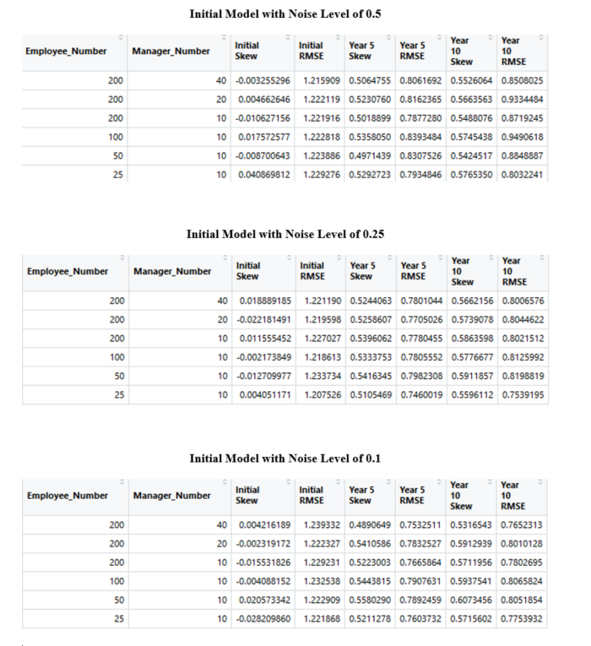
Results

Slide 8
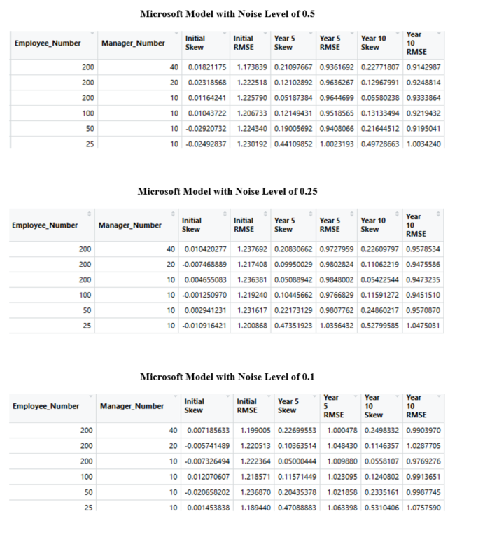
Results

Slide 9
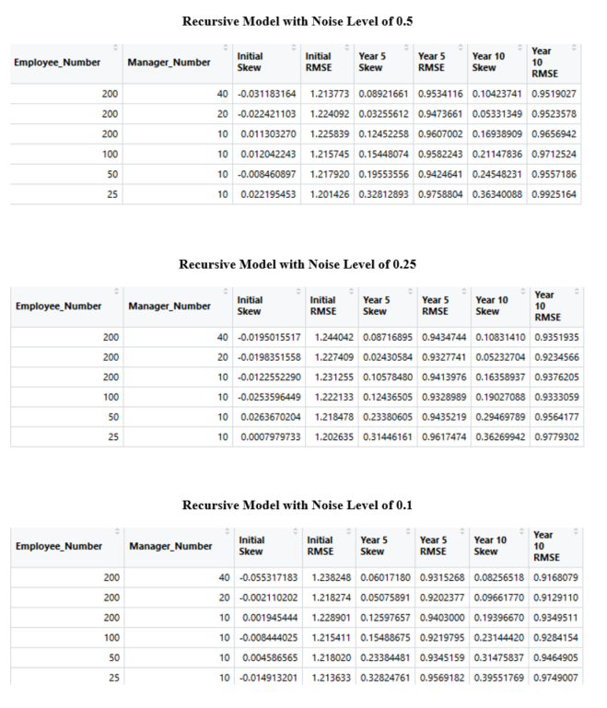
Results

Slide 10
Discussion
The Microsoft Model reduces score inflation but performs worse overall in total error
The Recursive Model performs better than the Microsoft Model in total error while still reducing score inflation
The Initial Model has the lowest total error between all three models
The consistent positive skew in the Initial Model makes it easier for upper management to account for the error as the direction is likely known

Slide 11
Future Work
Explore the effect of other variables currently excluded to refine results such as promotions and motivation
A new potential model by including employee scores by managers as in the Initial Model combined with an intrateam and interteam score like in the Recursive Model
Enrich the Initial Model by translating manager ratings based on their average inflation with respect to other managers
Further empirical work on this subject is also extremely important to match with potential models and to test ideas in the real world with vastly more variables and complications

